Slide 1
SLHS-SIM
Devika Pradhan
Hang Yang
Michael Wu
Taoyue Zhang
Spring 2015 Mid-Semester Design Review

Slide 2
Partners
In coöperation with the Purdue Department of Speech, Language, and Hearing Sciences (SLHS)
Primary contact:
Barbara Cicholski (Speech and language pathologist)
Anu Subramanian (Associate Professor at SLHS at purdue)

Slide 3
Objectives
To design and implement an online simulation of the Peabody Picture Vocabulary Test Fourth generation (PPVT-IV) for students studying in SLHS-related fields to practice administering the exam

Slide 4
Objectives
That includes:
1. Create an online database for storing the videos and forms.
2. Create a complete scoring and testing system on website, i.e. setting different stops for different level of users.
3. The last step is making the system work for other different tests.

Slide 5
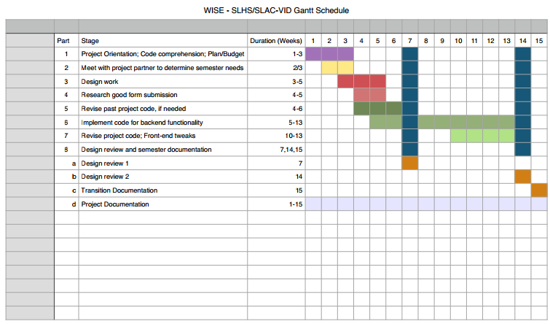
Timeline

Slide 6
Progress
Met with Prof. Cicholski to review last semester’s progress and revise any residual objectives
Cleaning up code from previous team’s work to better suit project needs
Clean and intuitive implementation of required functions

Slide 7
What We Have Done This Semester
Until now, our group have met with all the previous team members and project partner in the department of Speech, Language, and Hearing Sciences. From the meeting with the previous members, we understood what our project is about and what we should continue to do on this project.
More importantly, we received the actual form of the PPVT test and a CD-R of the simulation videos, which are the most crucial items we need in this project.

Slide 8
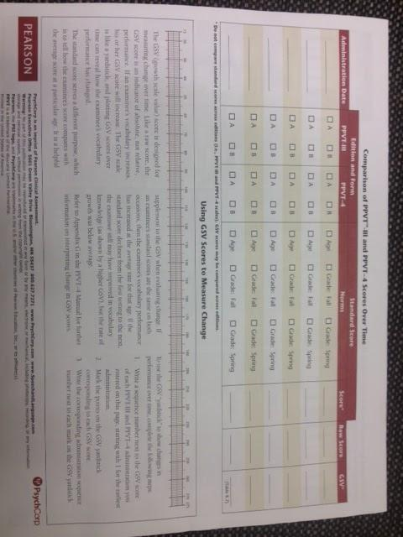
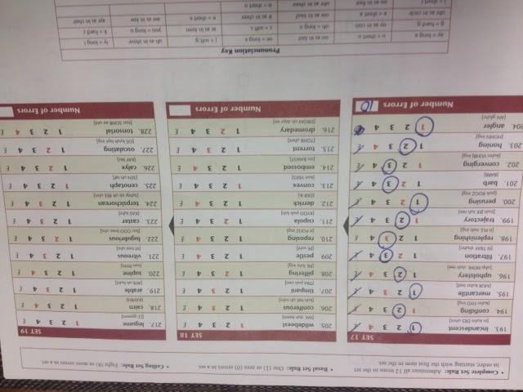
PPVT Form

Slide 9
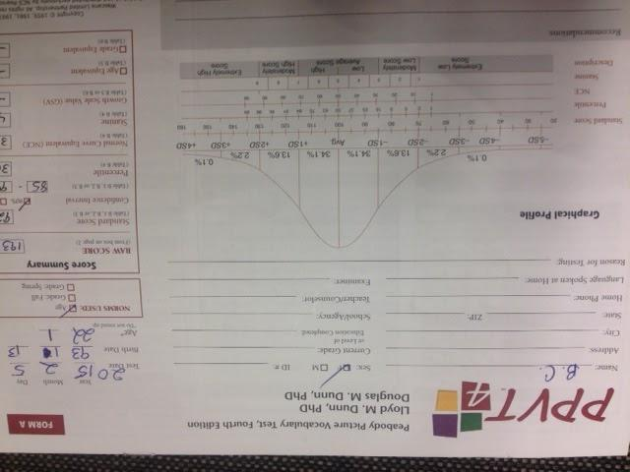
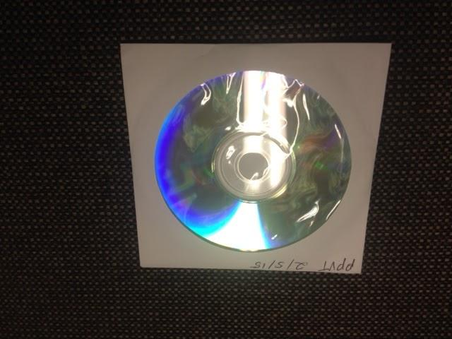
PPVT Form and CD

Slide 10
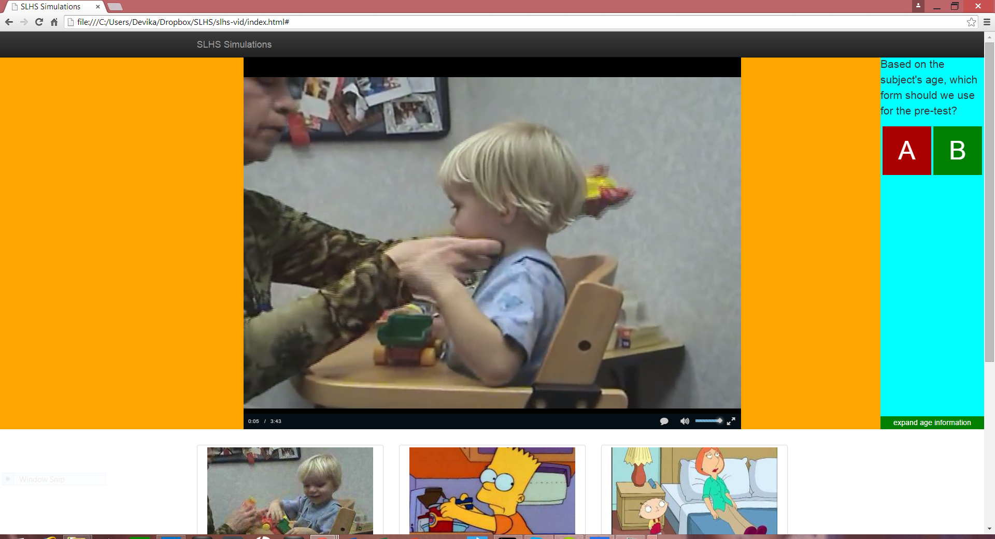
Simulation Slides

Slide 11
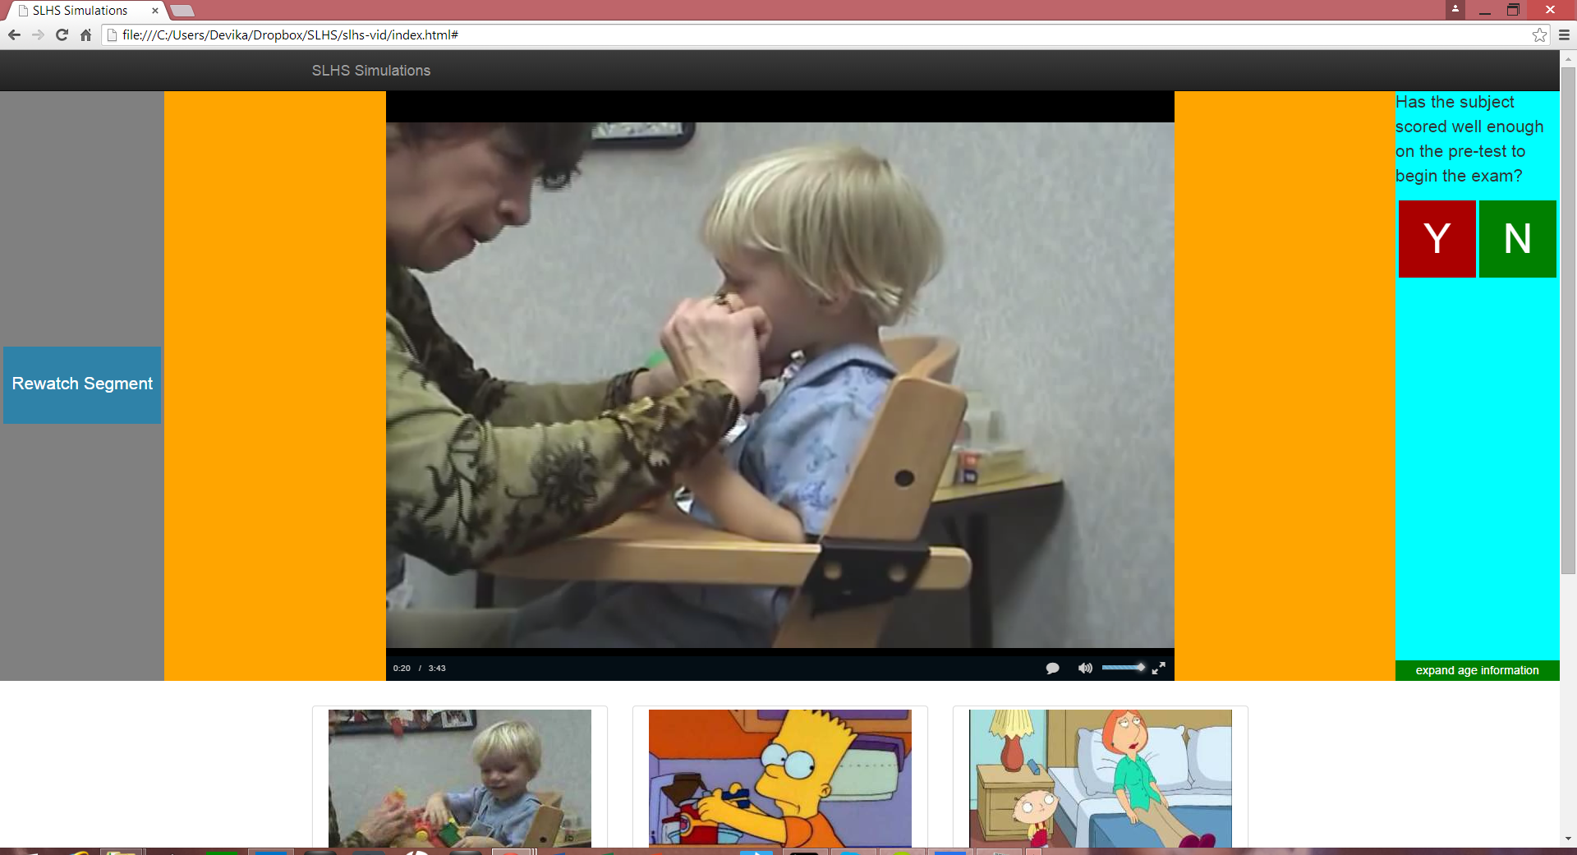

Slide 12
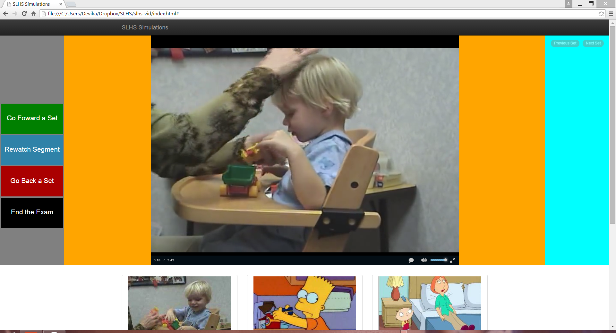

Slide 13
Specs of the Simulation and Code
The time stamps are flexible and at an interval of 18 secs approx
The simulation records user responses
Subject can review any segment of the simulation any time he wants.
Coded is JQuery and Java Script using online standard libraries.

Slide 14
SWOT Analysis
Strengths
We made the site more user friendly and flexible for the subject to experiment with.
Weaknesses
The simulation doesn’t incorporate all the constraints like age, number of past attempts in consideration, etc.
Opportunities
The same and more advanced specs can be used in the simulation video given by our PP.
Threats
For better results, we need all member to become proficient with coding

Slide 15
Semester Goals
As a team work on making the simulation vidoes subject friendly and making the site interactive. This involves completing all the objectives said before in the presentation.
Individually, we all want to use this opportunity to learn new coding languages.

Slide 16
